Slide 1
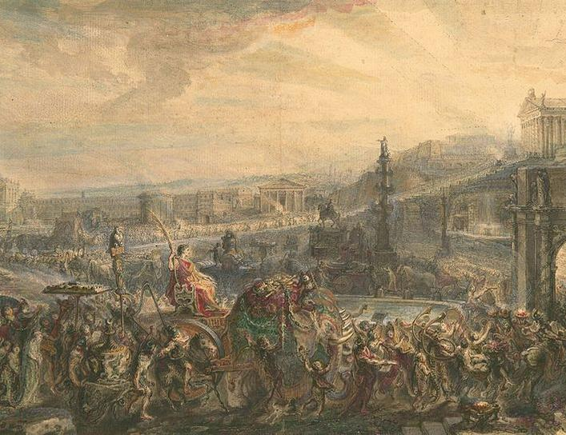
Year 12 Ancient History
LEARNING INTENTIONS:
- Define key terms
- Create a timeline
Week 5 Lesson 1
Ms Barrie

Slide 2
Year 12 Overview
SEM 1 - Unit 3 – Societies and change: Rome, the Late Republic to the Lex Manilia c. 133–66 BC
In this unit, students examine the evolving nature of societies and the various forces for continuity and change that exist. They also learn that values, beliefs and traditions are linked to the identity of a society. Students learn that in any period of change there are those individuals and/or groups that support change, but others that oppose it, and that there are different interpretations of the resultant society.
SEM 2 - Unit 4 – Confrontation and Resolution: Egypt, Akhenaten and the Amarna Revolution, Amenhotep IV/ Akhenaten to the death of Horemheb c. 1352 – c. 1295BCE
In this unit, students learn that there are internal and external forces that result in confrontation and resolution within societies, and these have consequences for continuity and change. Students assess how power is used, how different groups and individuals respond, and whether there is the potential for greater confrontation or more effective resolution to conflict.

Slide 3
Year 12 Semester 1 Overview
Week | Topic | Assessments
1 | Overview of Rome
2 - 4 | Roman Society (SPERMC)
5 - 6 | Tiberius and Gaius Gracchus (133 – 121 BCE) | 1 - Essay
7 - 8 | Gaius Marius (133 – 87 BCE) | 2 – Source Analysis
9 , 1 - 2 | Sulla (90 – 78 BCE)
3 - 4 | EST | 3 - EST
5 - 6 | Pompey (66 BCE) | 4 - Inquiry

Slide 4
Our Focus
Key people – their society and what they changed

Slide 5
This Week:
Lesson | Topic/Activities
Tuesday | Key terms Timeline
Wednesday | Key people
Thursday | Political Structure
Friday | Doco – Relief Teacher

Slide 6

ACTIVITY 1 - Timeline
Using the key dates provided, create a timeline of Ancient Rome

Slide 7
ACTIVITY – Key words
Using the key words provided, create flash cards
Simplify each of the terms

Slide 8
INSTRUCTIONS
Make a timeline of key events
OR
Make flashcards of key words

